Slide 1


Email Application
Batch – 2022 Pune
Under the Guidance of
Chittaranjan Ghosh
Priyanka Patil (6522)

Slide 2

Introduction
Email Application is an app where user can manage their emails.
Through this app one can compose an email to another person as well as one can receive email from any user that has register to the application.
The main objective of the email application is to track and monitor the emails through inbox.

Slide 3
Modules
Login/Register Module
Dashboard Module
Email Details Module

Slide 4
Features Of Application
Auto generated email Id through random function in Java.
User can search mail through receiver email id.
User Friendly GUI.
User can easily reply to any mail.
User can delete the unnecessary email in Inbox and Sent box.
User can update the password.

Slide 5


Technology Stack
Front end: Java Swing.
Back end: MySQL and Core Java Concepts.
Middleware/Server: MySQL
Operating System: Windows

Slide 6
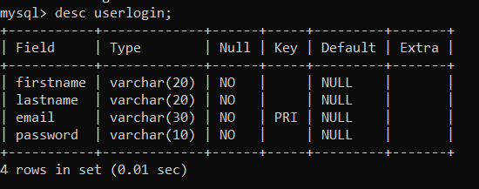
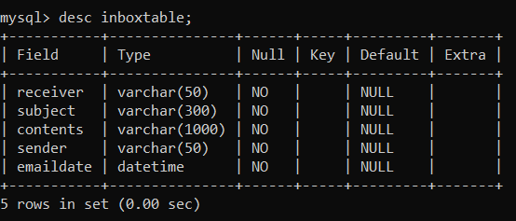
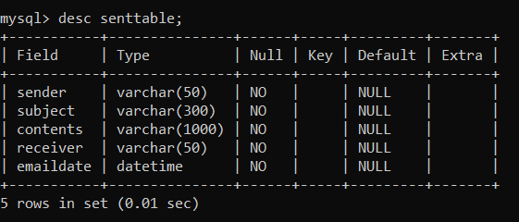
Data Dictionary

Slide 7
Screenshots

Slide 8
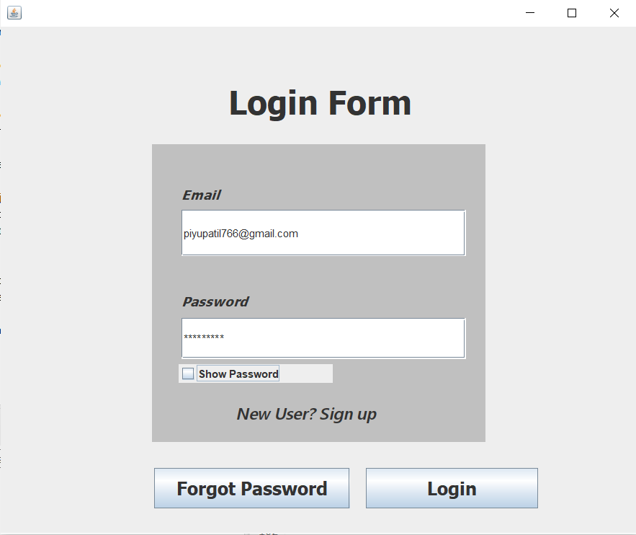
Login

Slide 9
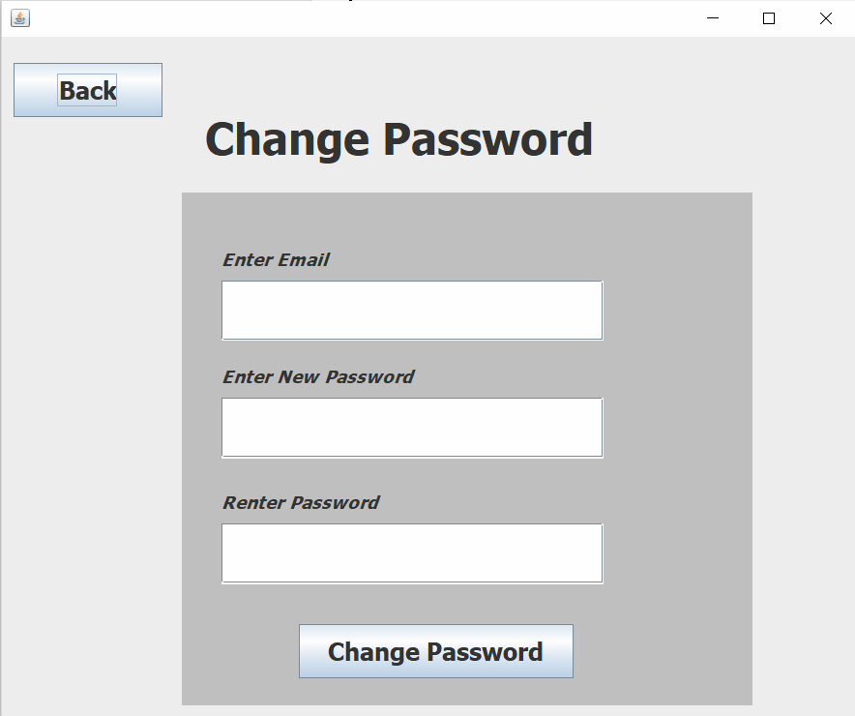
Change Password

Slide 10
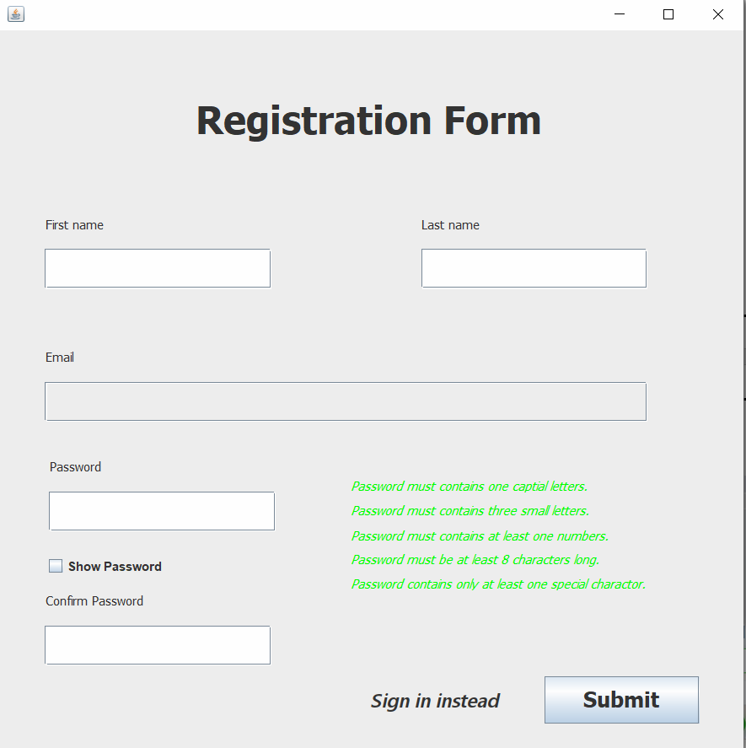
Registration

Slide 11
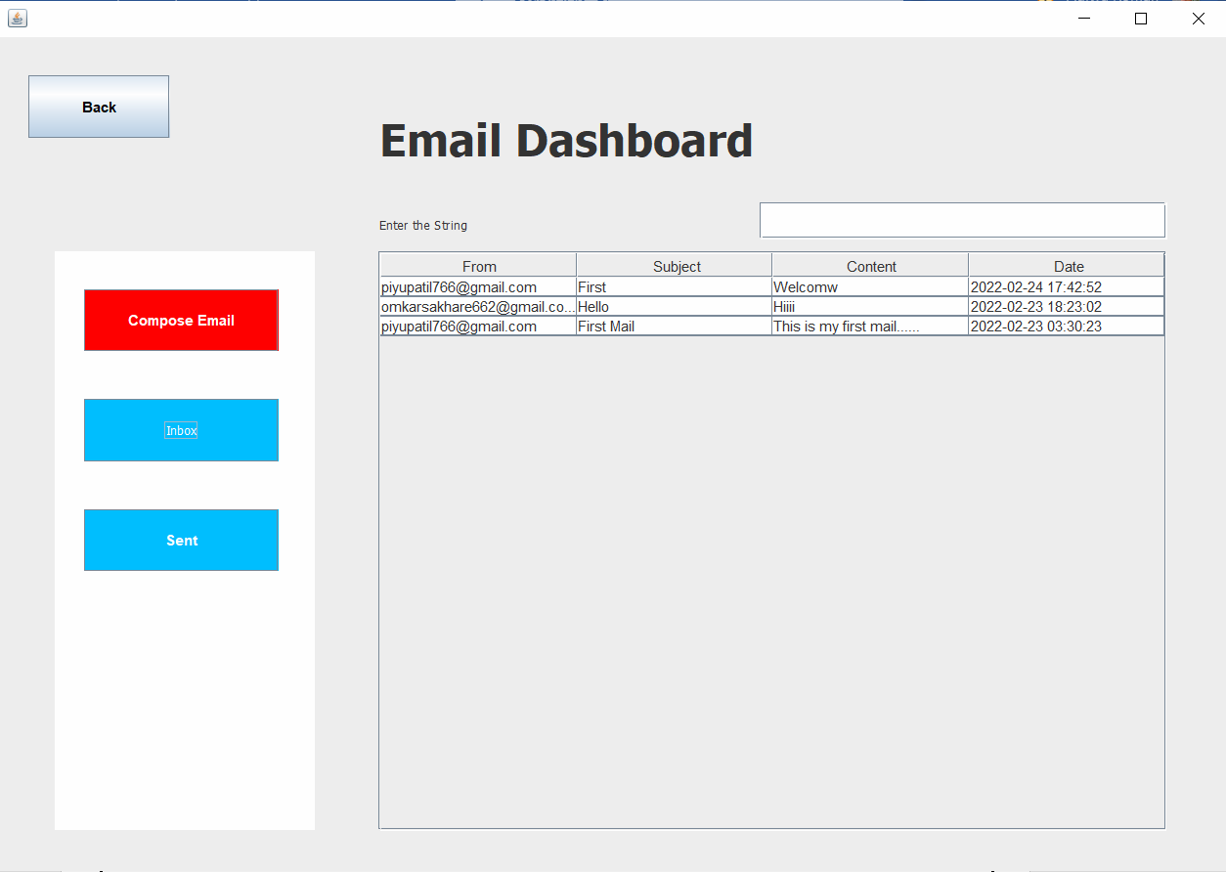
Email Dashboard

Slide 12
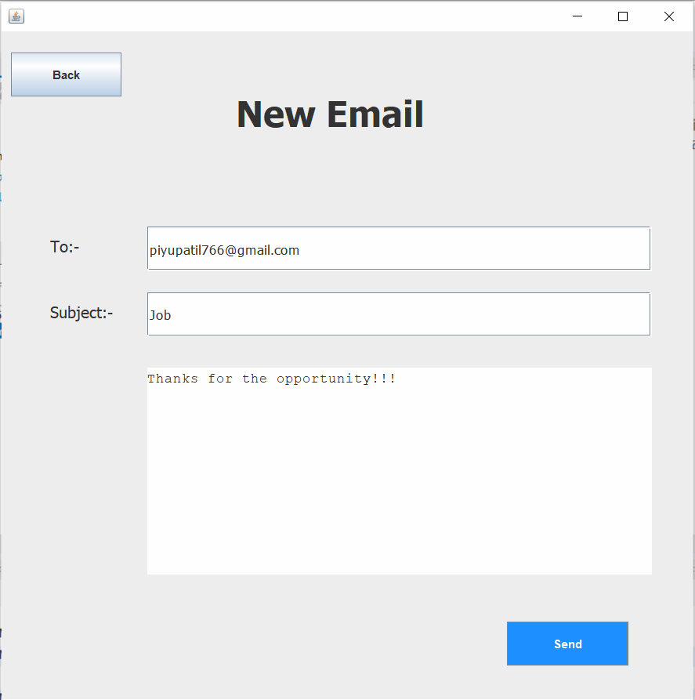
Compose Email

Slide 13
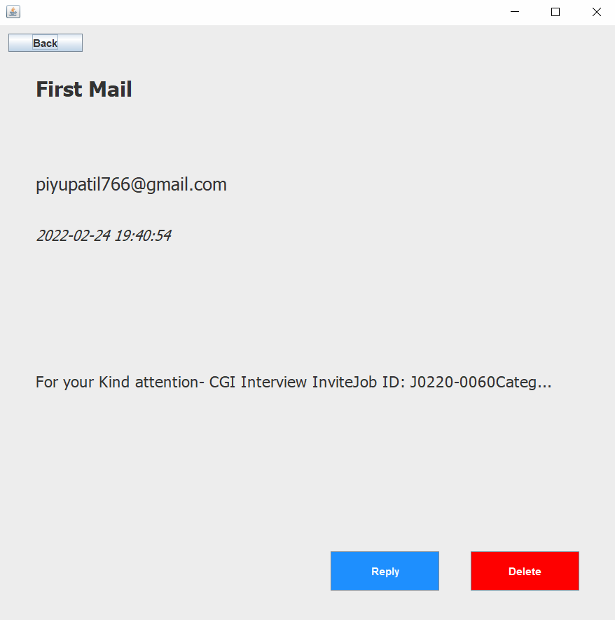
Email Details

Slide 14
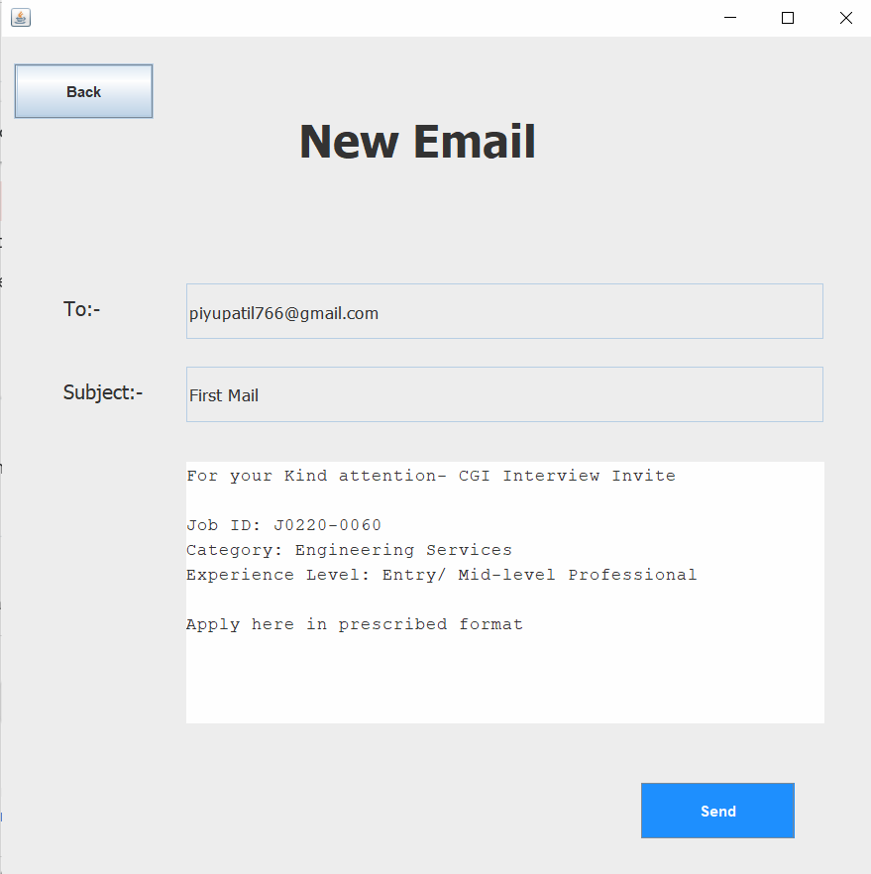
Reply Email

Slide 15


